Slide 1
The Principle of Work and Energy for Rigid Body Systems
Dr. Jacob Moore
Associate Professor of Engineering
Penn State Mont Alto

Slide 2
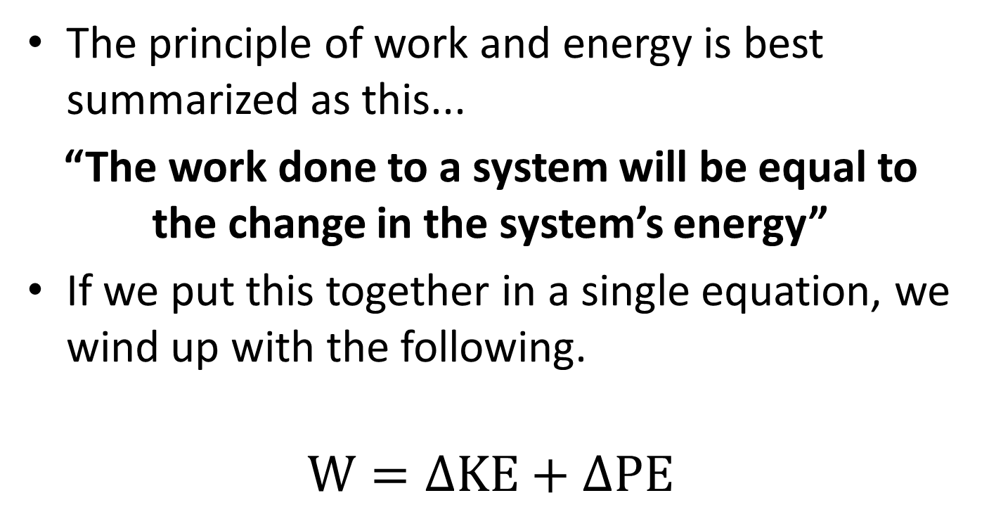
The Principle of Work and Energy
The principle of work and energy is best summarized as this...
“The work done to a system will be equal to the change in the system’s energy”
If we put this together in a single equation, we wind up with the following.
$$W=∆KE+∆PE$$

Slide 3
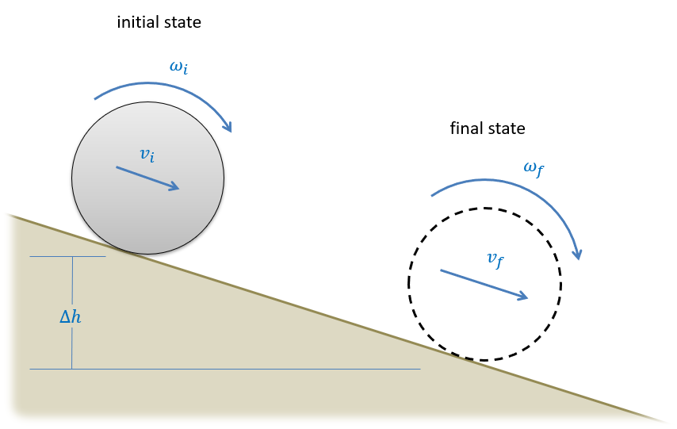
Setting up the Work and Energy Equation
To start a work and energy problem, we will need start by defining an initial and final state.
If possible, draw these out and label relevant information at each step.

Slide 4
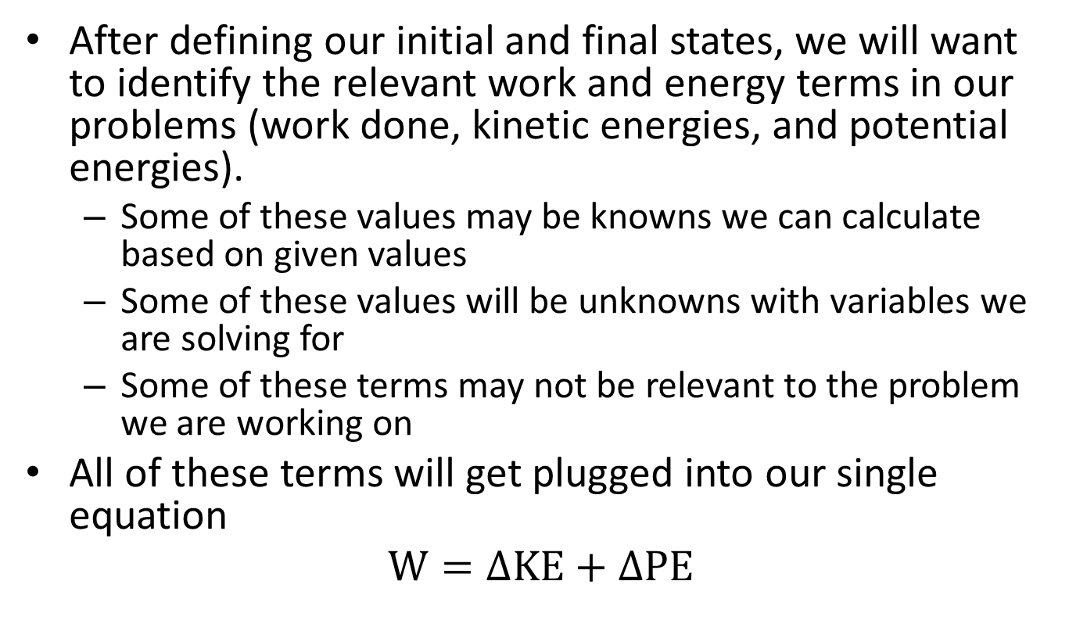
Setting Up the Work and Energy Equation
After defining our initial and final states, we will want to identify the relevant work and energy terms in our problems (work done, kinetic energies, and potential energies).
Some of these values may be knowns we can calculate based on given values
Some of these values will be unknowns with variables we are solving for
Some of these terms may not be relevant to the problem we are working on
All of these terms will get plugged into our single equation
$$W=∆KE+∆PE$$

Slide 5
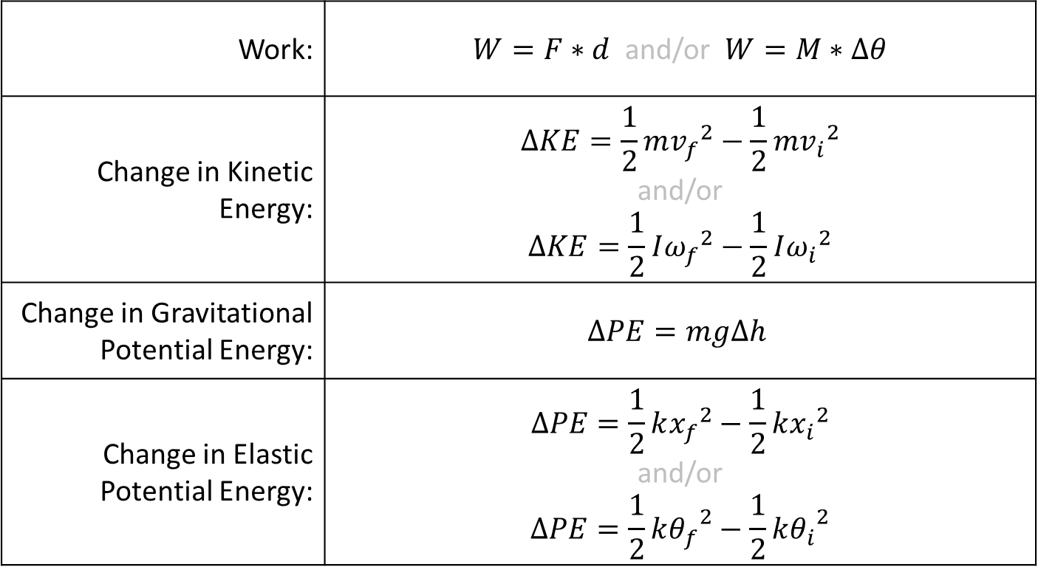
Work and Energy Terms
For rigid body systems, we have the following basic definitions…
Work: | $W=F∗d$ and/or $W=M∗∆θ$
Change in Kinetic Energy: | $$∆KE=\frac{1}{2}m{v_{f}}^{2}−\frac{1}{2}m{v_{i}}^{2}$$ and/or $$∆KE=\frac{1}{2}I{ω_{f}}^{2}−\frac{1}{2}I{ω_{i}}^{2}$$
Change in Gravitational Potential Energy: | $$∆PE=mg∆h$$
Change in Elastic Potential Energy: | $$∆PE=\frac{1}{2}k{x_{f}}^{2}−\frac{1}{2}k{x_{i}}^{2}$$ and/or $$∆PE=\frac{1}{2}k{θ_{f}}^{2}−\frac{1}{2}k{θ_{i}}^{2}$$

Slide 6
Work and Energy Methods and Kinematics
One of the primary limitations of the work and energy method, is that it only results in a single equation.
Because we only have a single equation to work with, we can only solve for a single unknown.
For this reason, we will often need to supplement the one equation with other kinematic relationships.
Relate linear and angular velocities
Relate positions and displacements for potential energies

Slide 7
Solving the Work and Energy Equation
The last step in the process will be to solve the equation for the unknown value.
Or equations and values, if you have kinematic relationships as well.
With only a single equation it should not be too difficult, however the single equation can often get quite large, so simplifying the equation in steps may be useful.
Do pay attention to signs, generally some energies increase while others decrease.

Slide 8
Work and Energy with Systems of Rigid Bodies
The same process as applied to a single body can also be applied to a system of bodies.
When the equation is applied to a system of bodies, remember that only external forces can do work on the system.
In the example to the right, the moment exerted by the pulley is external, but the tension force in the cable is an internal force.
Kinetic and potential energies can be lumped together, the energies of the components can simply be counted individually

Slide 9
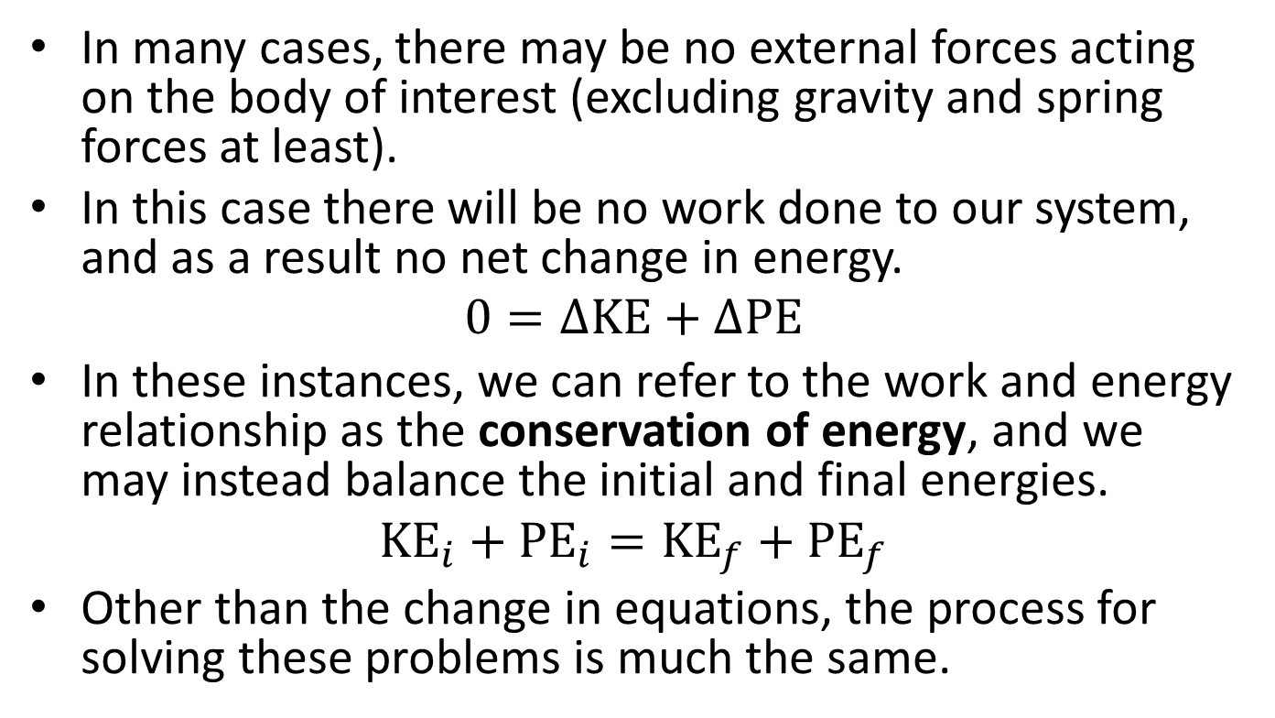
The Conservation of Energy
In many cases, there may be no external forces acting on the body of interest (excluding gravity and spring forces at least).
In this case there will be no work done to our system, and as a result no net change in energy.
$$0=∆KE+∆PE$$
In these instances, we can refer to the work and energy relationship as the conservation of energy, and we may instead balance the initial and final energies.
$${KE}_{i}+{PE}_{i}={KE}_{f}+{PE}_{f}$$
Other than the change in equations, the process for solving these problems is much the same.

Slide 10
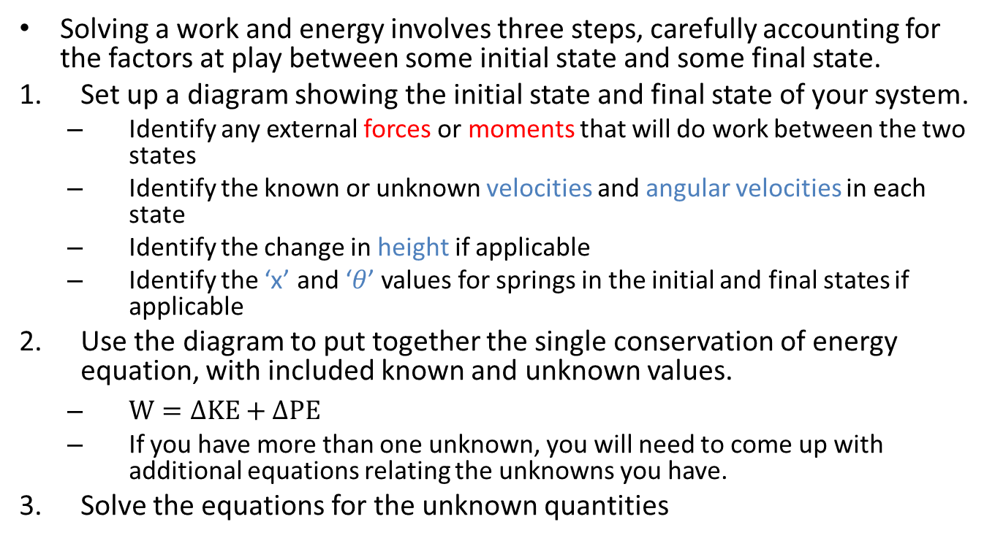
Solving a Work and Energy Problem (The Process)
Solving a work and energy involves three steps, carefully accounting for the factors at play between some initial state and some final state.
Set up a diagram showing the initial state and final state of your system.
Identify any external forces or moments that will do work between the two states
Identify the known or unknown velocities and angular velocities in each state
Identify the change in height if applicable
Identify the ‘x’ and ‘$θ$’ values for springs in the initial and final states if applicable
Use the diagram to put together the single conservation of energy equation, with included known and unknown values.
$W=∆KE+∆PE$
If you have more than one unknown, you will need to come up with additional equations relating the unknowns you have.
Solve the equations for the unknown quantities

Slide 11
Thanks for Watching
See other engineering mechanics videos and access the full tool at…

Slide 12





initial state
$$ω_{i}$$
final state
$$v_{i}$$
$$ω_{f}$$
$$v_{f}$$
$$∆h$$

Slide 13
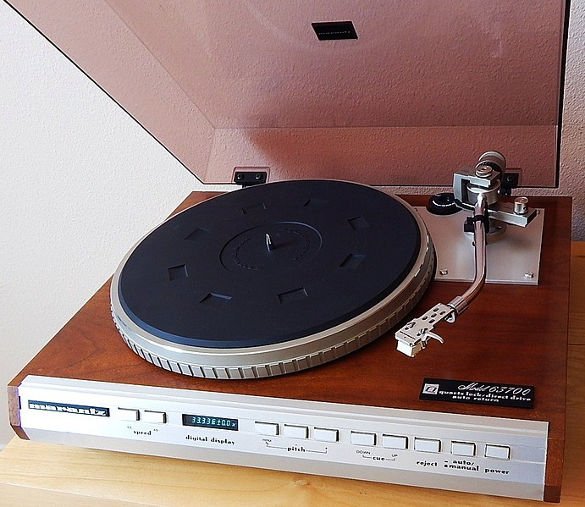
Worked Example
The turntable on a record player consists of a disk 12 in in diameter with a weight of 5lbs. If the motor accelerates the turntable from rest to it’s operating speed of 33.33 rpm in one rotation.
Determine:
The work done by the motor.
The torque of the motor exerts.

Slide 14
Worked Example
A system as shown below is used to passively slow the lowering of a gate. The gate can be approximated as a flat plate on its edge with a mass of 25 kg and a height of 2m.
What would the angular velocity of the gate be without the spring?
If we want to reduce the angular velocity at the bottom to 25% of it’s original value what should the spring constant be? Assume the spring is upstretched as shown in the diagram.
1m
.7m
1m

Slide 15
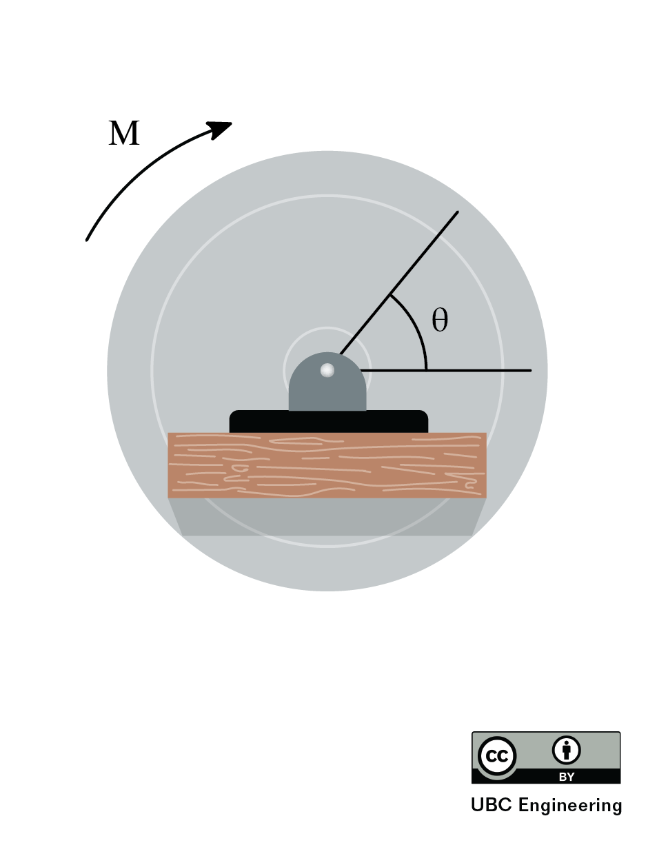
Worked Example
If a couple moment M=(θ²+2θ+2)Nm is applied to a disk, determine the work of the couple moment after the disk has rotated 4 times. What would be the sign of the work if the moment was applied in the opposite direction?

Slide 16
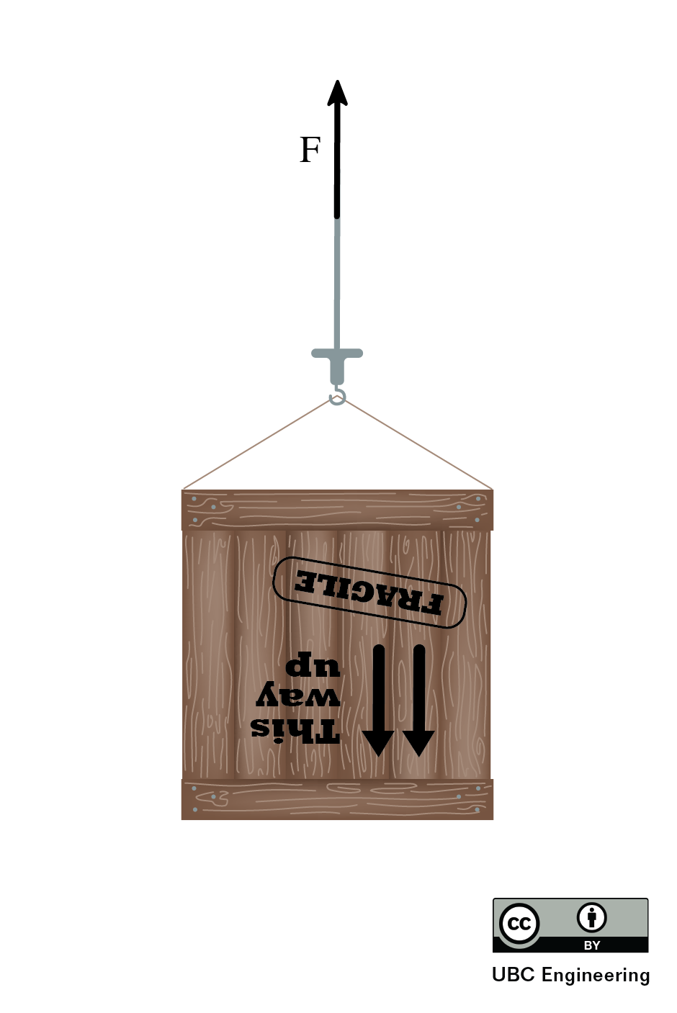
Worked Example
A crane lifts a crate with mass 30kg using a cable. If the crane applies a force of 400N and lifts it up to a height of 5m, determine the work done by both the crane and gravity, and the crate’s final velocity if it started from rest.

Slide 17
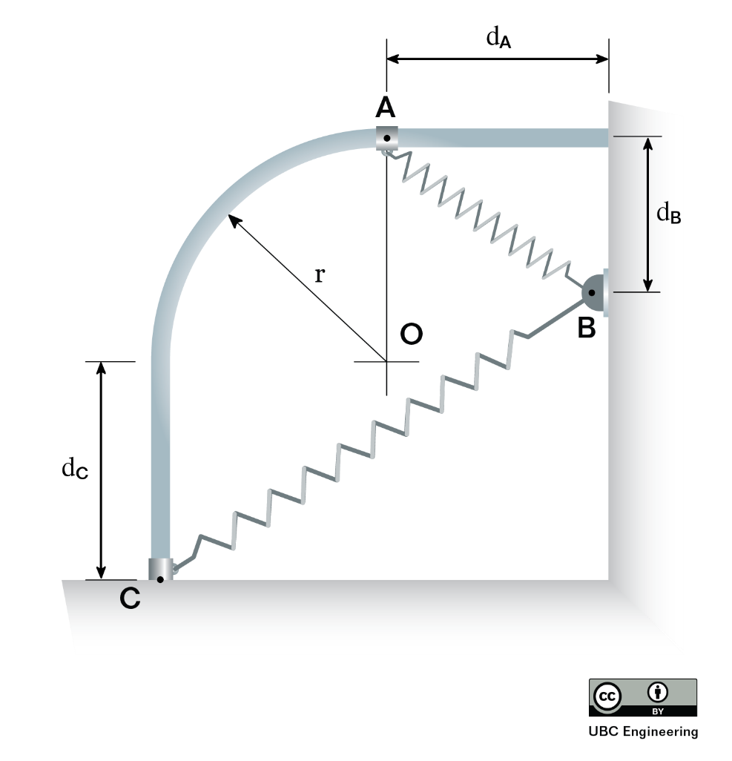
Worked Example
Find the potential energy at point A and at point C. Determine which location has greater potential energy. The collar has mass m=0.8kg and the spring has a constant k=600 N/m. Point A is located a horizontal distance of d_{A}=0.6m away from the wall while point C is located a vertical distance of d_{C}=1.3 m below point O on the diagram. Point B is located a vertical distance d_{B}=0.9 m below point A and the track has a radius r=0.2 m. The unstretched length of the spring is l₀=0.12 m.

Slide 18
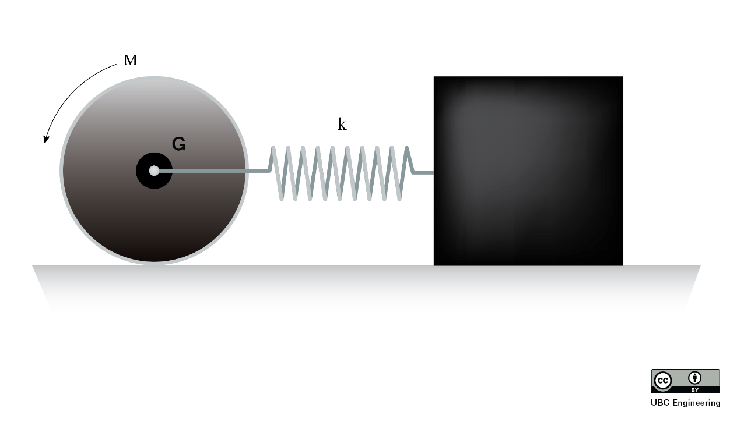
Worked Example
A lazy engineer is designing a robot to move things for him. He places a hub motor inside a 2.5 kg disk such that a couple moment of M=2.943 Nm is applied. If the attached package has a mass m=5 Kg and the coefficients of kinetic friction and static friction for between all objects are μ_{k}=0.2 and μ_{s}=0.4 respectively, determine the angular velocity of the disk after its center of mass has travelled a distance d=0.5 m. Assume the disk rolls without slipping and the package does not tip. The disk has a radius r=0.3 m, the spring constant is k=100 N/m and the spring is unstretched originally.

Slide 19
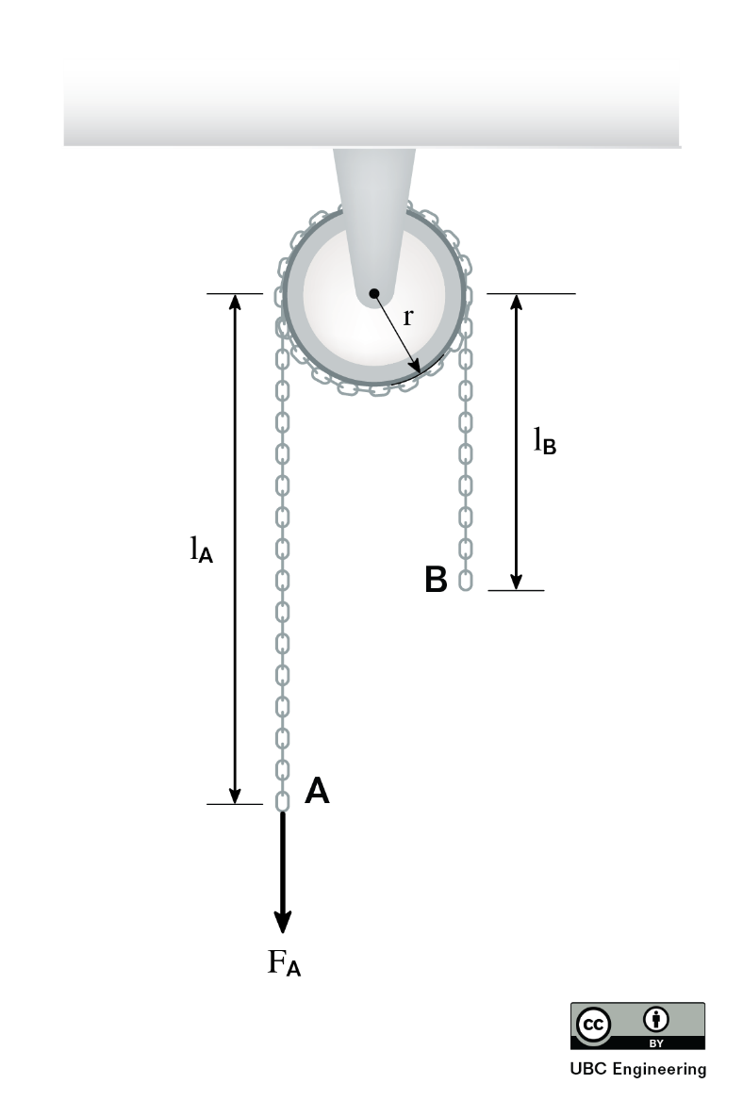
Worked Example
For a summer, you’ve taken a job at your uncle’s auto shop. You pull on the left side of a chain wrapped around a pulley with a force of F=50 N. The pulley has a mass m=20 Kg and a radius r=0.2 m. If the chain has a mass of 3.4 Kg/m, determine the angular velocity of the pulley after it has rotated θ=90 degrees. There is l_{A}=3 m of chain hanging off the left side and l_{B}=2 m hanging off the right side of the pulley. Assume the chain does not slip and that the system was released from rest just before you pulled on it. Assume the pulley can be modelled as a disk.

Slide 20
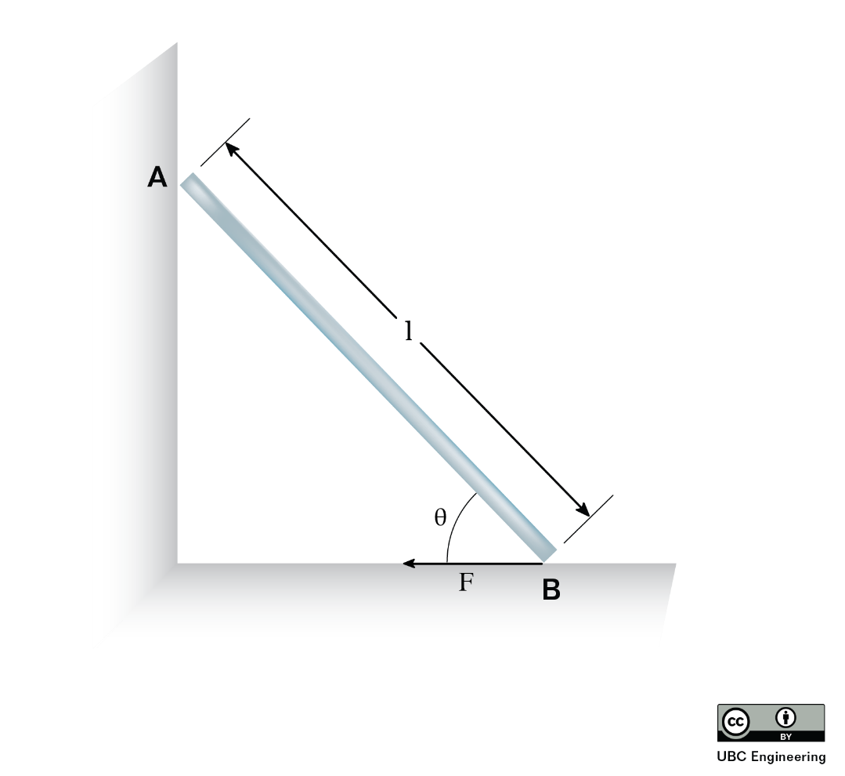
Worked Example
A 30kg sheet of ice with length l=1.5 m at an angle θ=30 degrees has a force F=650 N applied at B. Determine the magnitude of the angular velocity of the plank when it reaches a vertical position. Assume the sheet acts like a thin plate and that contact between the sheet and all surfaces is frictionless.

